Slide 1
Place and Liveability
Year 7

Slide 2
Perception
Perception:
The way you think about or understand something.
It can contain bias.

Slide 3

How many do you see?

Slide 4
Perception is influenced by:
Age
Income
Household type
Gender
Cultural background
Education
Note these influences.
Can you think of three more influences?

Slide 5
Contrast different perceptions:
Older people vs teenagers
People with children vs people without children
A disabled person and an able bodied person
What do you think these different groups believe makes a place liveable?
Choose 1 or 2 or 3
Discuss with a partner and share with the class.

Slide 6
Liveability Ratings
General categories to assess liveability:
Public safety
Housing affordability
Aesthetic (attractive)
Accessibility to transport
Recreational, educational & health facilities
Utilities (electricity, water, sewerage systems)
Environmental (climate, open space, air quality)
Telecommunications infrastructure

Slide 7
City vs country
City – What are the advantages?
Greater range of jobs
Access to a wide range of shops and services
Greater choice of schools
More entertainment options
Faster pace of life
Access to a wide range of medical facilities
Think of three disadvantages.

Slide 8
City vs country
Country – What are the advantages?
Space
Lack of crowds
Cleaner air and less pollution
Cheaper housing
More opportunities for outdoor activities
Think of three disadvantages.

Slide 9
City vs country
When you are an adult do you think you will live in a city or in the country?
Name a place you would like to live.
Why do you think so?
What is important to YOU for liveability?
Will your needs and perceptions change over time? Why? Why not?
Discuss these questions in a group.

Slide 10
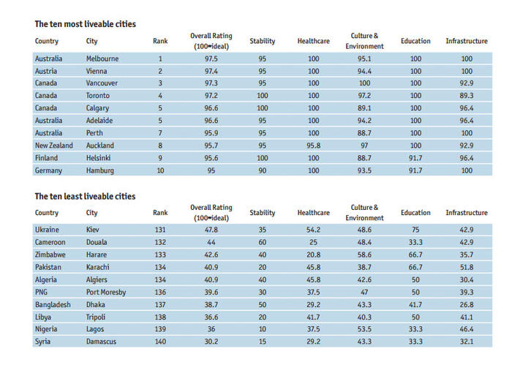
Most to least liveable cities 2017

Slide 11
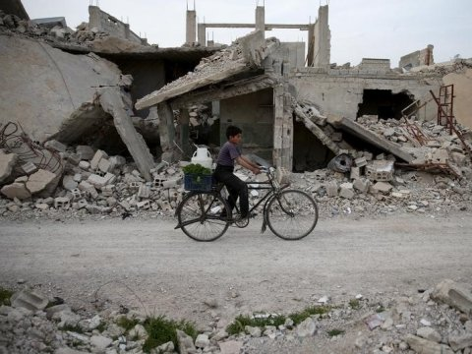
The Syrian capital of Damascus saw the second biggest decline in liveability, falling 16.1 points from 2016.
Damascus was the lowest-ranked city with a rating of just 30.2 out of 100, scoring poorly in all categories due to Syria’s civil war.
Kiev, the only European city in the bottom ten, performs better for health care and education but has a low stability score due to Ukraine’s ongoing conflict with Russia.

Slide 12


Safety and Crime
Liveability of a place declines if people fear death or damage to property.
The Terrorism Risk Index ranks Somalia followed by Pakistan as most at risk countries.
The Global Peace Index ranks Iceland, New Zealand and Denmark most peaceful.
What rank does Australia hold?
Peace
Millions of people live in dangerous countries where kidnapping, murder, disease, terrorism and theft affect well being.

Slide 13

Global Peace index
Australia ranks……………… # 25

Slide 14
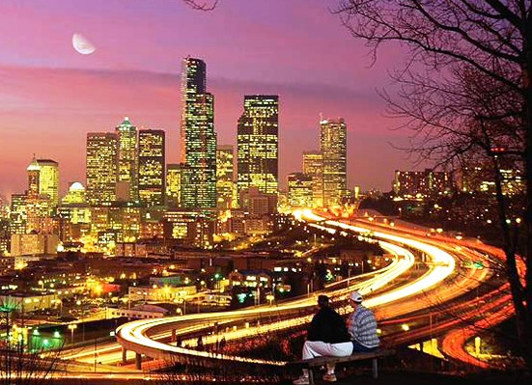
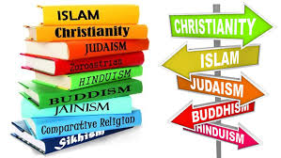
Large cities
People have lived in
cities for thousands of
years.
Cities develop around:
Trade
Defence
Religion
Culture
Political power
Why would early cities have been located on harbours and rivers?

Slide 15

positives and negatives
Positives:
Efficiency
Convenience
Concentration of resources (educational/medical)
Better social integration
Negatives:
Crowding
Lack of sanitation
Crime
Unemployment
Slums

Slide 16
Skyscrapers and Sprawl
Housing Density: is the number of dwellings in an area of land. High density housing includes apartments and skyscrapers. In developing countries, millions of people live in slums.
Sprawl: as cities grow, lower density housing spreads outwards from the CBD to surrounding farmland and natural environment.
In Australia, the government want to minimise urban sprawl.
FACTS!!
In Singapore 60% of people live in sky scrapers.
Mumbai, India houses 34,000 per square km.

Slide 17
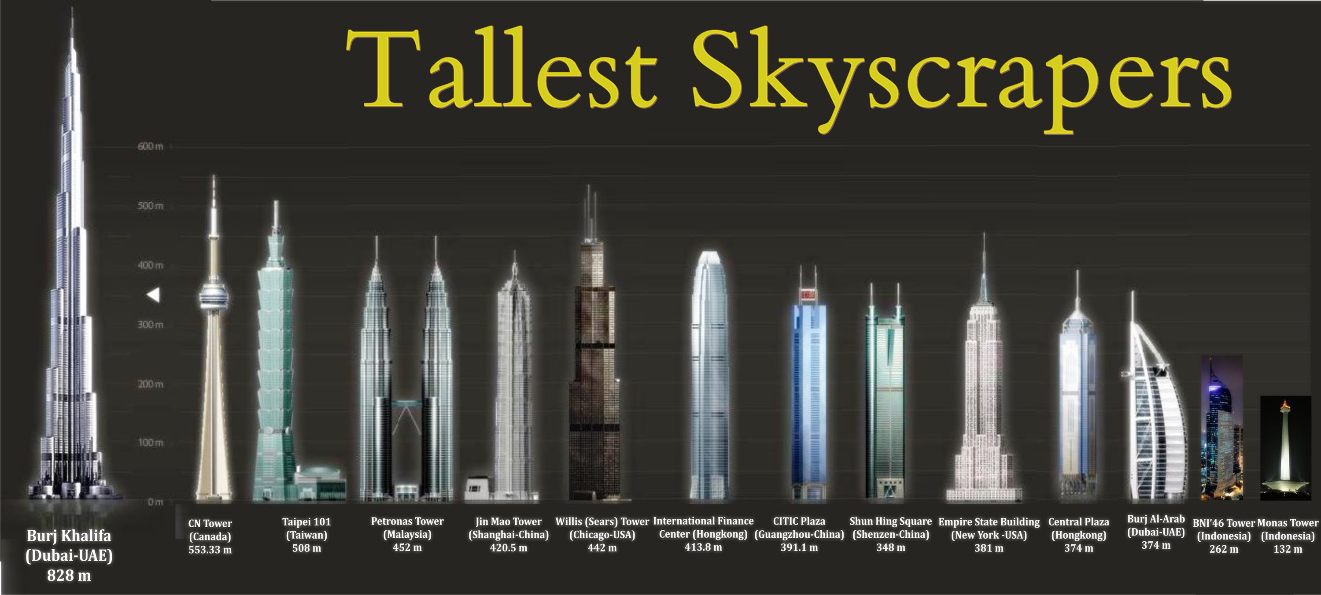
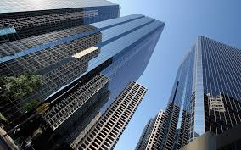
skyscrapers

Slide 18
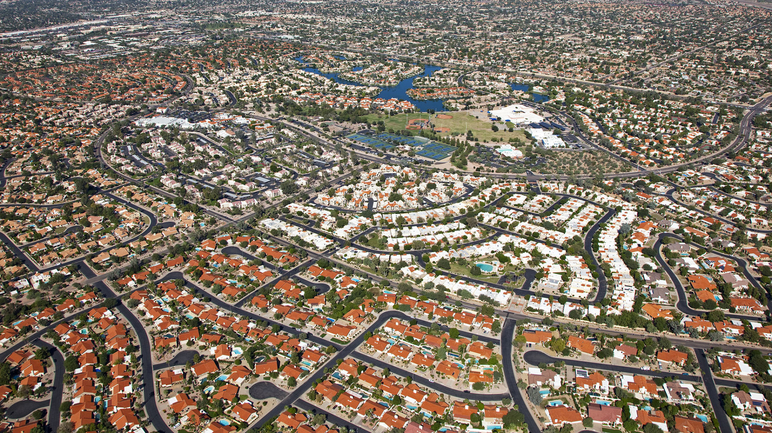
Urban sprawl

Slide 19
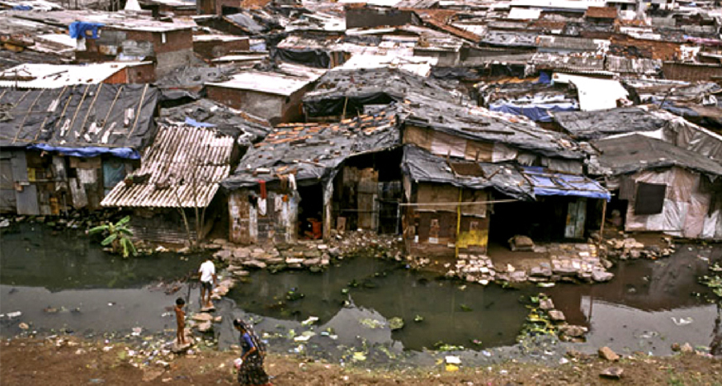
slums

Slide 20
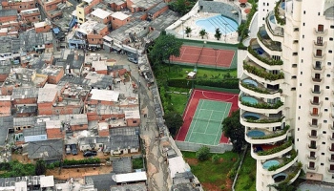
Slums and apartment building side by side

Slide 21
Megacities
Megacity: A megacity is defined by the United Nations as a metropolitan area with a total population of more than 10 million people.
As of 2017, there are 37 megacities in existence.
The largest of these is:
Tokyo - 38.8 million
By 2025, China, the world’s most populated country, will have eight megacities.

Slide 22
Urbanisation and megacities
https://www.youtube.com/watch?v=-ApGzilTwBU
Megacities are known as cities with more than __________ million people.
Where in the world are the majority of megacities?
What is the population of Jakarta today?
There is a great ____________ of wealth in Jakarta.
Describe two of the problems faced by Indonesian's living in Jakarta.
What things are World Vision doing to help improve the lives of Indonesians?

Slide 23
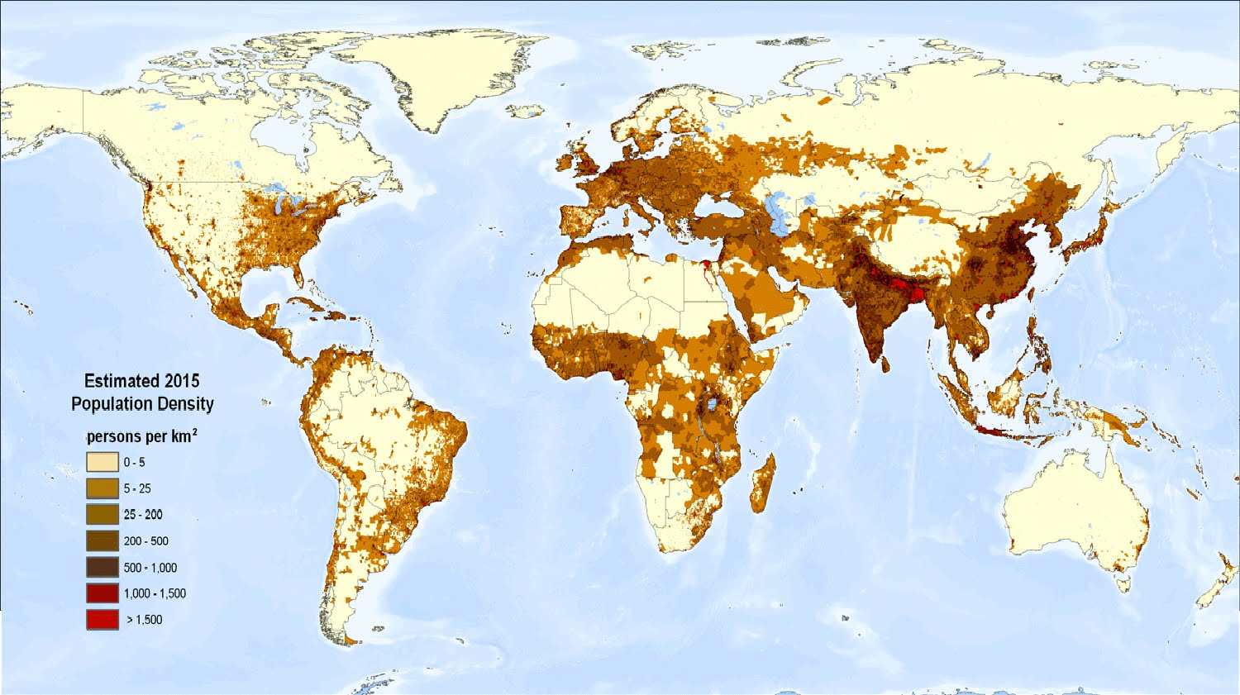
World population density map

Slide 24
Where we live
Where in Australia do you live? How far from the coast are you?
The Australian mainland covers an area of 7,659,861 square km. Australia is the world's sixth-largest country, with close to 36,000 km of coastline.
Overwhelmingly, this is where most Australians live, with more than 85 per cent of the population living within 50 km of the coast.
Are you part of that 85 per cent?

Slide 25
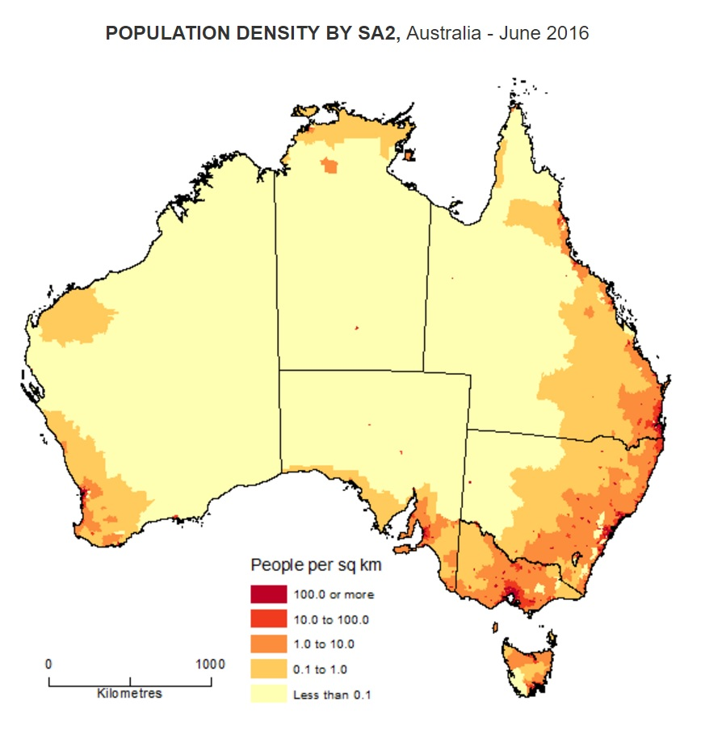
Where Australian's live

Slide 26
THE COASTAL LANDSCAPE
Increasing numbers of Australians are moving to coastal areas or to rural areas further inland, to leave the pressures of urban life behind.
Many people believe that coastal areas are the most liveable parts of the Australian environment.

Slide 27
The coastal landscape
As a result, many coastal communities around Australia are under pressure to provide for a rapidly growing population. Many of these areas also have to cope with the large numbers of visitors and tourists.
The infrastructure and economy of coastal environments will directly impact on their liveability.

Slide 28
Best place to live
http://splash.abc.net.au/home#!/digibook/1278012/where-s-the-best-place-to-live-

Slide 29
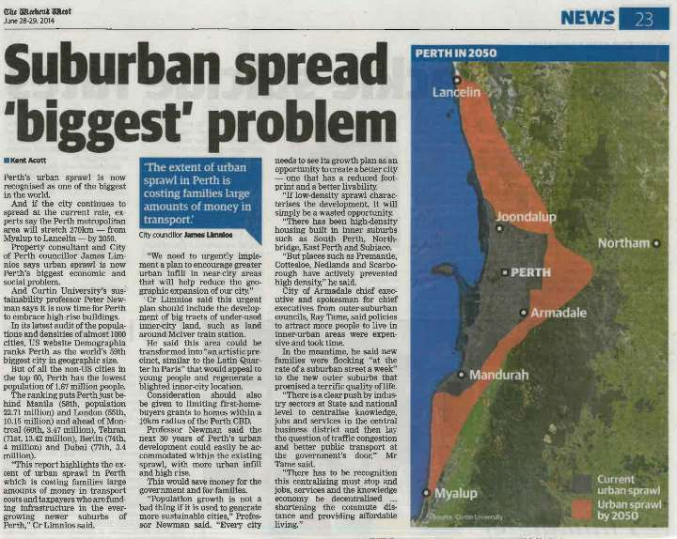
Urban sprawl in perth
Perth is one of Australia's most sprawling cities, with an urban area that stretches approximately 100 km along the Indian Ocean coastline, from Two Rocks in the north to Mandurah in the south.

Slide 30
HOW CAN WE IMPROVE LIVEABILTY IN OUR TOWNS AND CITIES?
Brainstorm 3 ways we could improve the areas we live in

Slide 31
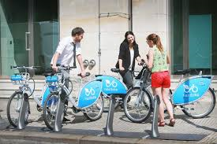
How to improve liveability
It's not hard to find ideas that could be used to enhance the liveability of our cities.
Across the world people are coming up with ideas to improve our towns and cities
In the German city of Leipzig, a simple 'bike sharing' system is helping to reduce congestion and to make the city more liveable.
It has the added social benefits of being good for people's health while being better for the environment.

Slide 32
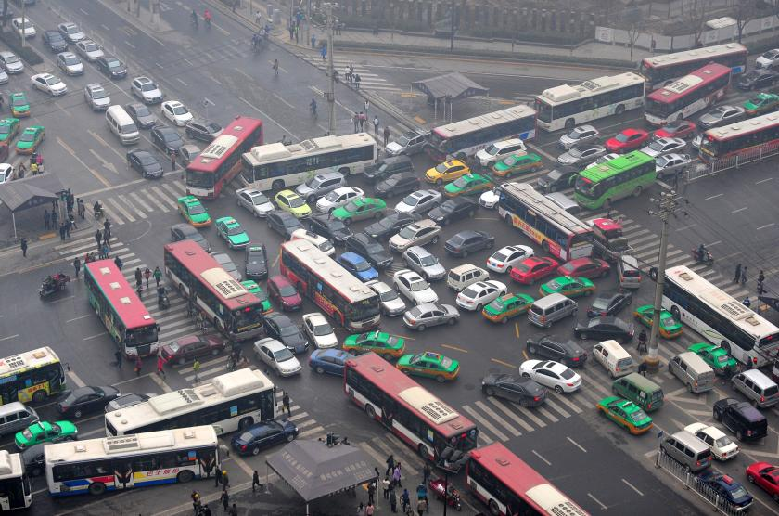
Limit traffic congestion
Definition: when vehicles travel at slower speeds because there are more vehicles than the road can handle. This makes trip times longer, and increases queuing.

Slide 33
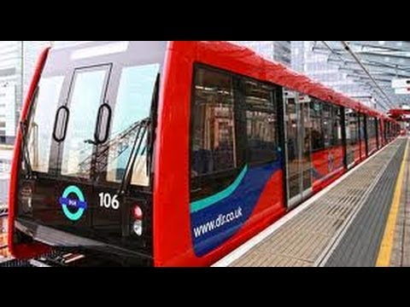
Light rail in london
In London they have a Docklands Light Rail (DLR) system.
This was set up to reduce congestion in a city with a population of approximately 8 million.
DLR's fully automated and driverless vehicles provide 300,000 journeys between the redeveloped Docklands area and central London each day, easing congestion on surrounding roads.

Slide 34
Mapping activity
Using your blank map of Australia and an Atlas find and mark the following using a red, blue or black pen.
1. The capital cities in Australia (Black pen)
2. The states of Australia (red pen)
3. Three rivers anywhere in Australia (blue pen)
4. Identify BOLTSS, draw a border, draw in the north arrow, add a key/legend, add a title. You don’t need to put a scale or source, but you do need your name at the bottom of the map. 5

